Slide 1
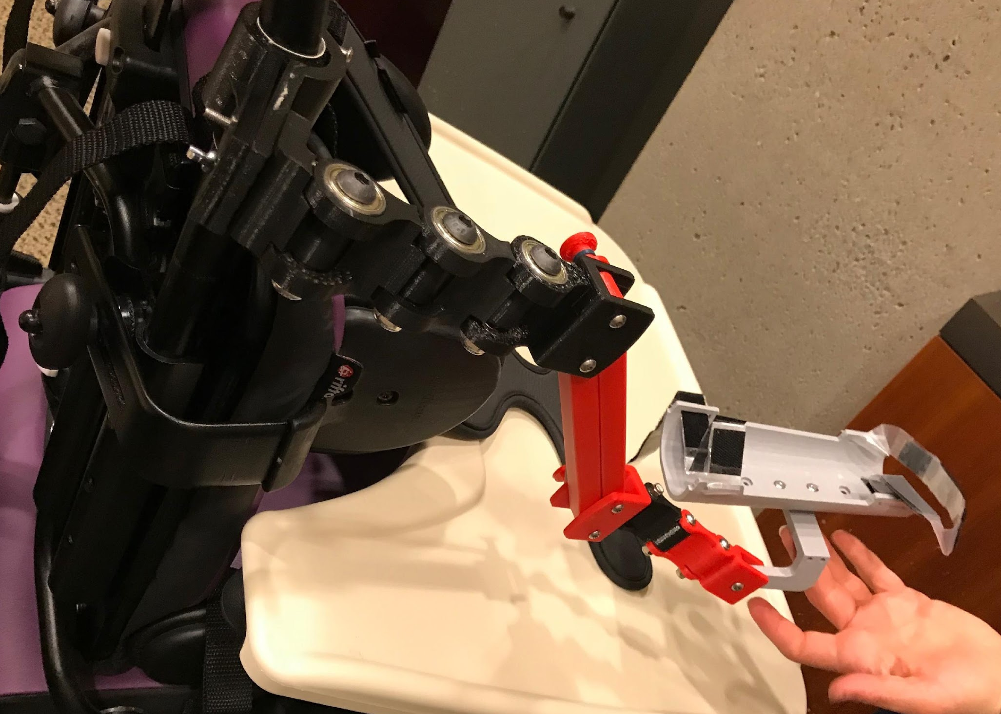
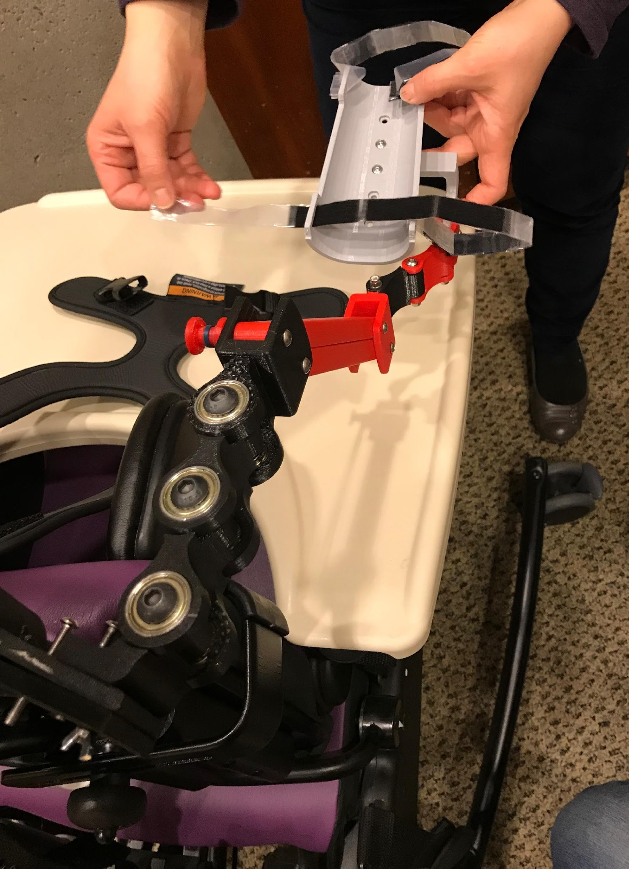
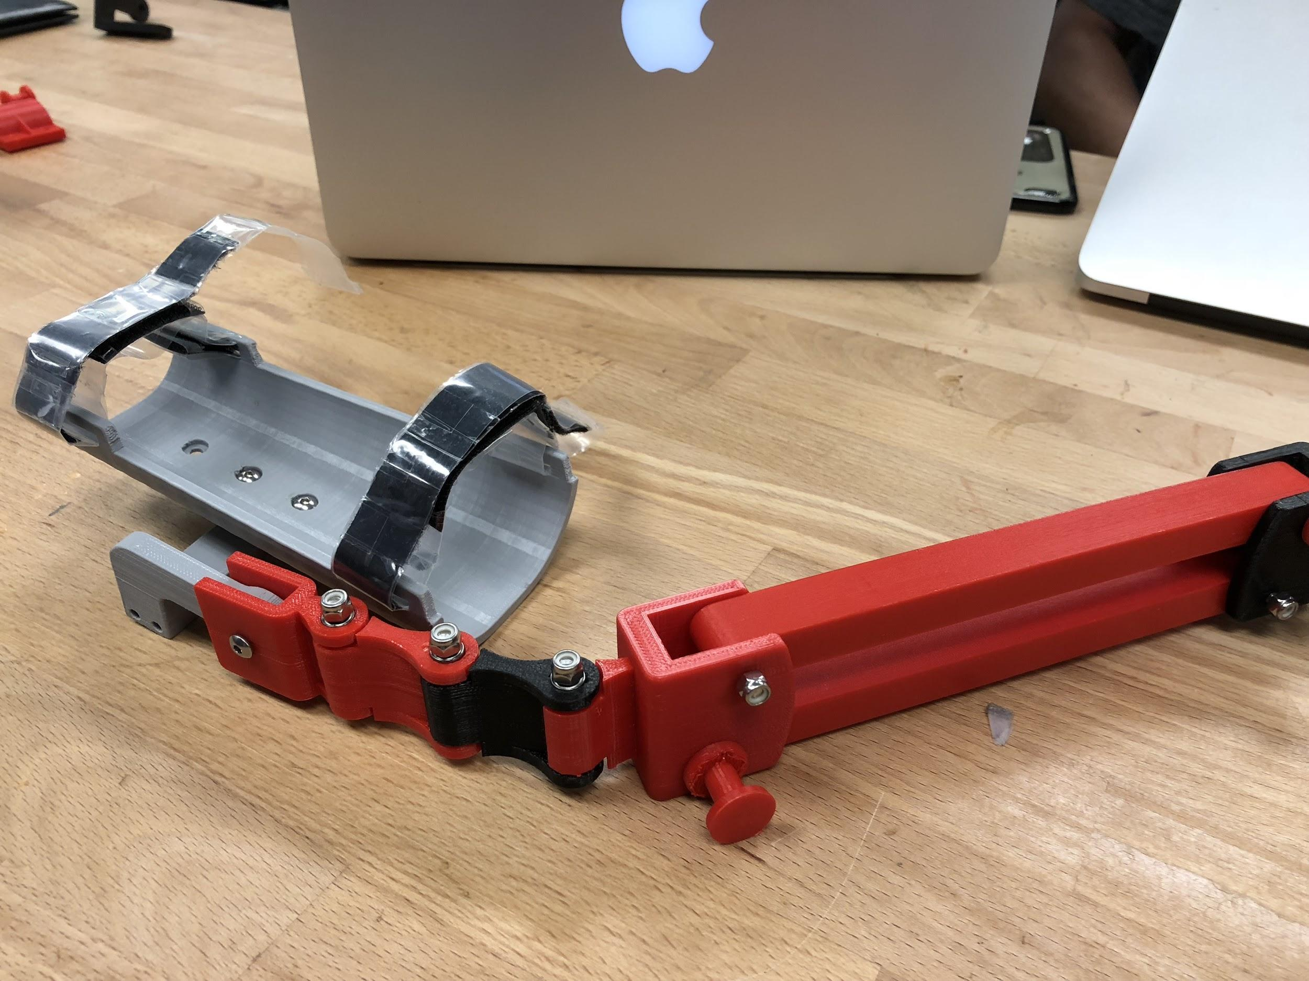
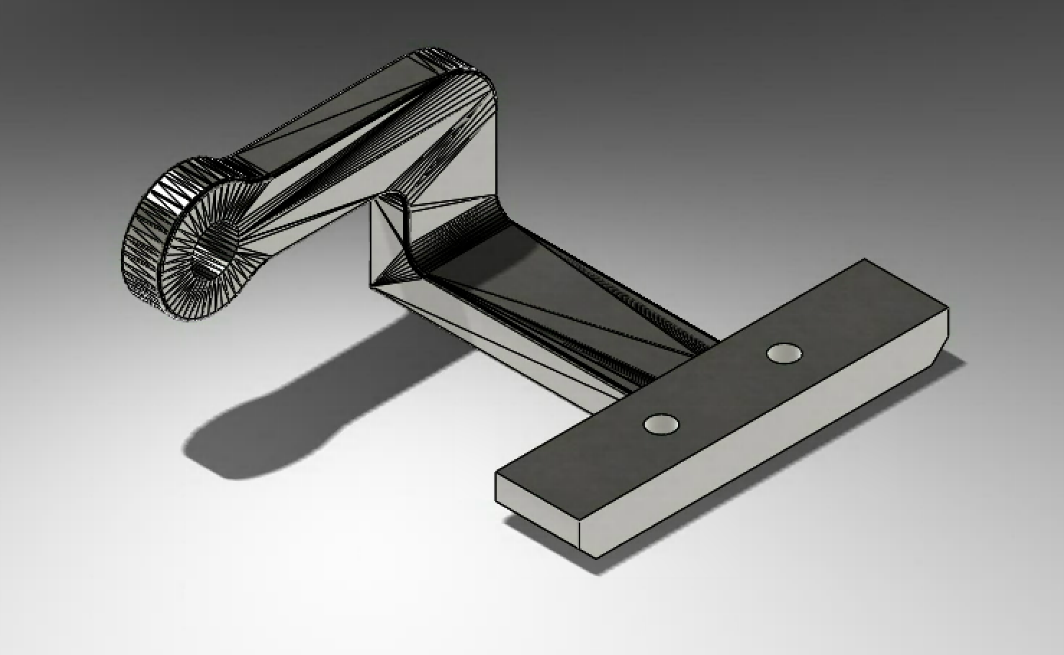
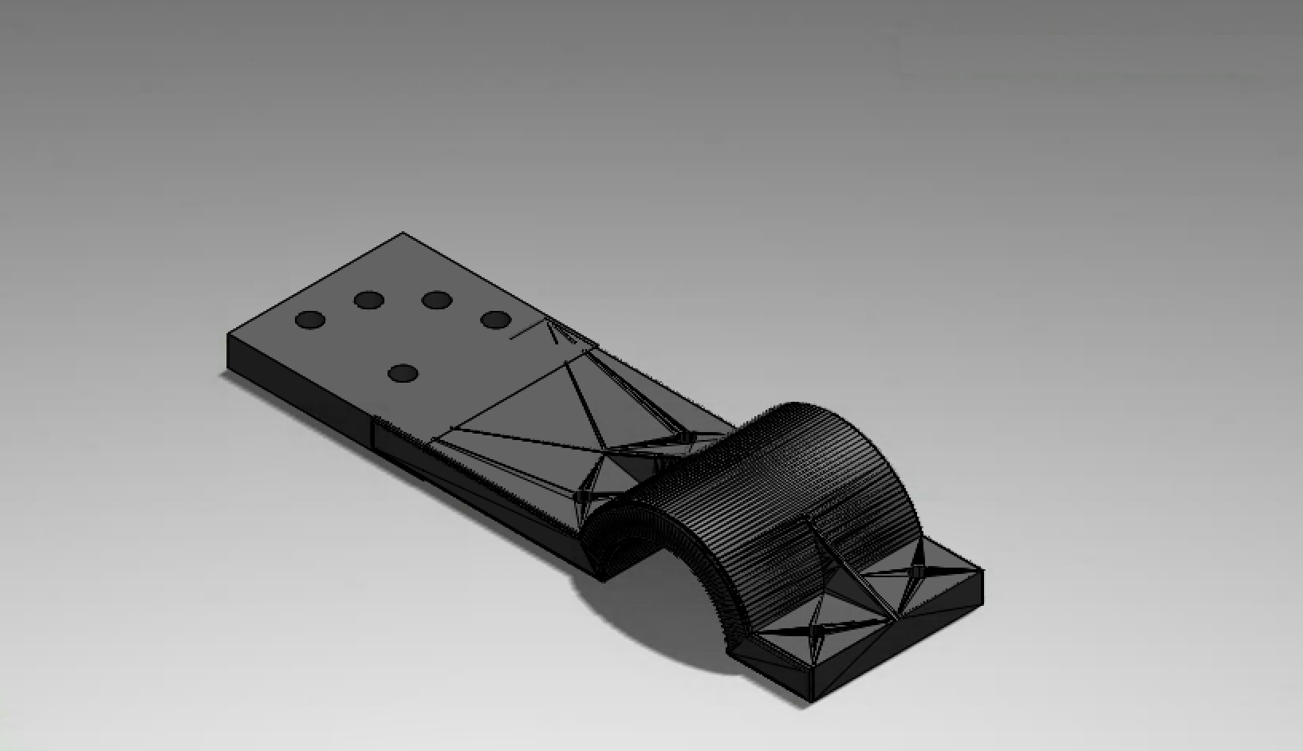
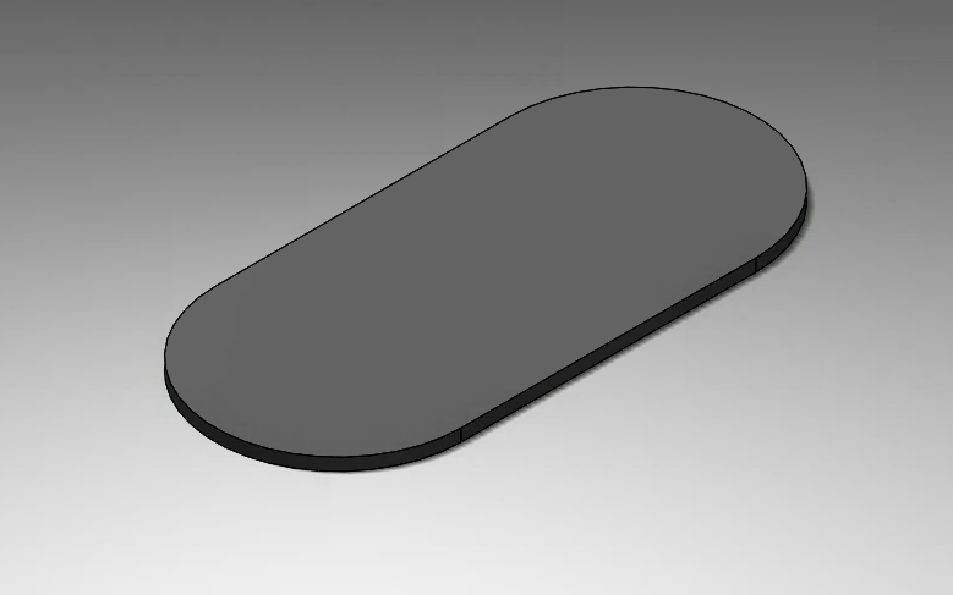
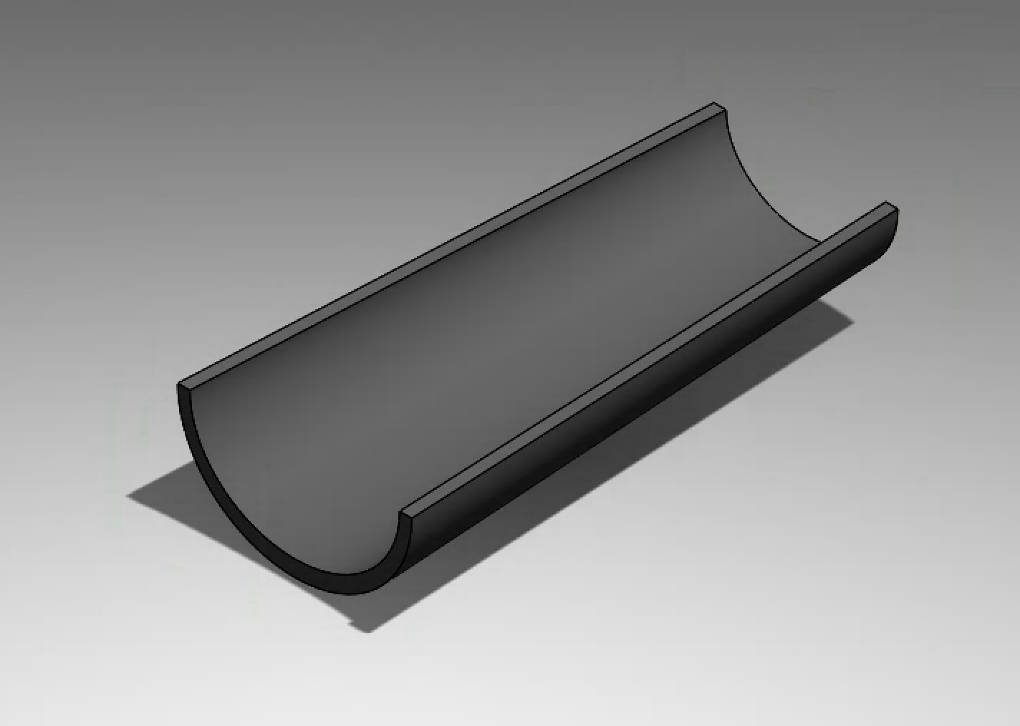
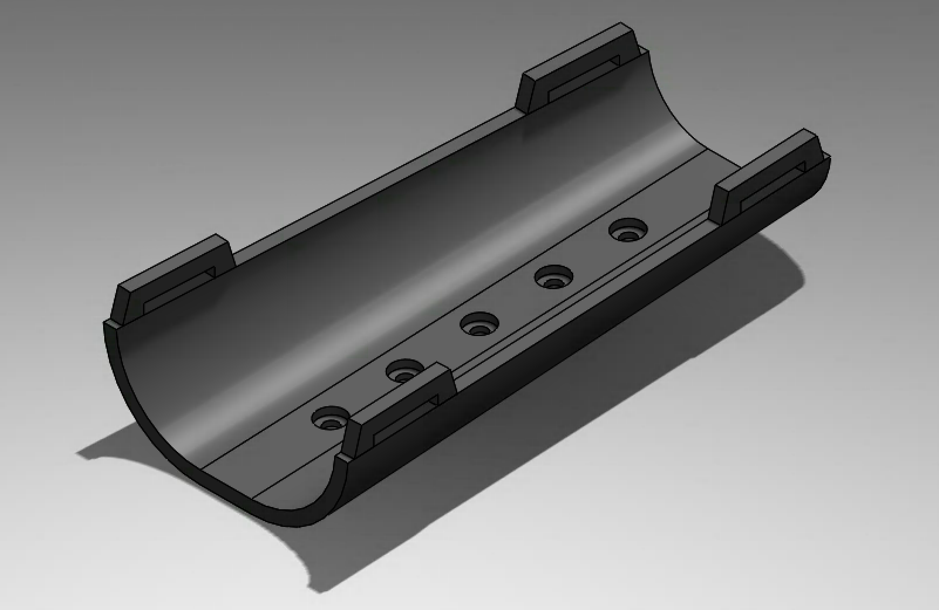
Magic Arm
Victoria Chow, Edgar Onofre, Brian Do, Will Lin, Andrew Love, Anat Caspi
HuskyADAPT
The Challenge
Magic arms are orthotic exoskeletons that assist people with neuromuscular deficits through harnessing elastics bands to achieve near total anti-gravity influence on an upper-extremity. Such a design would help children with limited mobility to participate in their daily activities by increasing functional use of their upper extremity.
Various designs, such as the JAECO WREX magic arm, have been successful in both feasibility and reaching the market. However, many of the current arms are not as accessible due to high expense, limited number of vendors, and a difficult assembly process. Other non-market arms have been constructed through the maker community but are not customizable and durable.
Goal
The goal is to redesign an existing upper-extremity orthosis that requires less-specialized manufacturing equipment and improves the accessibility. We sought to redesign a 3D Print magic arm based on maker Mike Turvey’s modified JAECO arm with considerations to assembly documentation, customization, and durability while maintaining the arm’s low cost.
The Design
Below is the complete prototype based on Mike Turvey’s design as well as some of the parts that had been redesigned.
COMPLETE PROTOTYPE
Figure 1: Magic Arm prototype April 19, 2018
REDESIGN PARTS
Figure 2: Forearm tray mount design
Figure 3: Pole mount adjustor design
Figure 4: Forearm tray progression (left to right)
Next Steps
Adjustor: smaller degree intervals within a 30º angle
Increase link strength (material thickness increase)
Test different materials (PLA, ABS, foam, etc.)
Replace springs with rubber bands
Incorporate supination and pronation motion to forearm tray
Completing and consolidating our assembly documentation/instruction manual
Acknowledgements
Nataliya Rokhamanova, Brianna Goodwin, & Jessica Zistatsis
Notes:
You can move the headings and sections included in the poster template as you wish. However, your poster should highlight:
The Challenge (use a well polished point of view or need statement, include some description of your need experts, take ample space to make this very clear!)
-- After looking at this section, your audience should have a good idea of what your challenge is AND why it is important!
-- It should be clear from your poster what current solutions include and why they don’t meet your POV
-- Some other sub-sections or sub-headings you might include in this section could be Core Functions (what does your solution need to do to satisfy need), Current Solutions (what exists and why don’t they meet the need), Motivation (add extra emphasis for why this is important), Broader Applications (beyond your need expert, what are the broader impacts or applications of this challenge)
Make sure someone can quickly see and describe the main features/innovations of your design by quickly looking at your poster.
Consider how you will interact with and use the poster during the demo night as a backdrop to share your design with others.
Design Ideas (should be the main focus of poster)
-- This section should highlight your leading 1-3 design ideas
-- Make sure someone can quickly see and describe the main features/innovations of your design by quickly looking at your poster.
-- Remember that the purpose of this design review is to get feedback on your design ideas – what can you put in this section to maximize the amount of useful feedback you can get?
-- Items you might want to highlight include models, sketches, quotes or initial feedback you’ve received, initial prototypes
-- Highlight how your design idea is unique and meets the challenge you outlined above
Next Steps (Where are you headed? What is your goal by the end of next quarter?)
Use this as an opportunity to use positive language and focus on the abilities and expertise of your need experts!
Consider how you will interact with and use the poster as a backdrop to share your design with others. What other props or interactive activities do you want to bring?
Keep text to a minimum (use bullets and lists). Make sure all text is large enough to be read from a distance of 2 meter, nothing smaller than 36 pt font.
Use images, graphs, and tables instead of text whenever possible.
We will print the posters – please do not change the overall size of the poster.

